Slide 1
PrognosAI: AI-Driven Predictive Maintenance System Using Time-Series Sensor Data

Slide 2
Introduction
PrognosAI is an AI-based predictive maintenance system designed to estimate the Remaining Useful Life (RUL) of industrial machinery using multivariate time-series sensor data. It leverages deep learning models such as LSTM to predict potential failures before they occur, ensuring timely maintenance and reduced downtime.

Slide 3
Motivation
Unplanned machinery failures in industries lead to high repair costs, production loss, and safety hazards. Predictive maintenance using AI allows early fault detection, enabling proactive maintenance scheduling. This enhances reliability, minimizes costs, and improves operational efficiency.

Slide 4
Objectives
- Design and develop a predictive maintenance system using AI and time-series data.
- Estimate Remaining Useful Life (RUL) of machinery using deep learning.
- Implement LSTM-based sequential pattern recognition for failure prediction.
- Reduce unplanned downtime and optimize asset utilization.
- Ensure model generalization for turbines, pumps, and motors.

Slide 5
Project Workflow :
Data Ingestion: Load and preprocess CMAPSS dataset.
Feature Engineering: Create rolling window sequences and compute RUL targets.
Model Training: Train LSTM/GRU models for RUL prediction.
Model Evaluation: Evaluate using RMSE and compare predicted vs actual RUL.
Risk Thresholding: Define alert thresholds for maintenance.
Visualization & Output: Display RUL trends and alert zones via dashboards.

Slide 6
Tech Stack :
- Python – Core programming language
- Pandas, NumPy – Data processing
- Matplotlib, Seaborn – Visualization
- TensorFlow / Keras – LSTM model training
- Scikit-learn – Metrics & preprocessing
- Streamlit / Flask – Dashboard or API interface
- Docker – Optional deployment
- NASA CMAPSS Dataset – Source data

Slide 7
Model Training and Evaluation:
A LSTM deep learning model was developed to predict the Remaining Useful Life (RUL) of engines.
The model was trained using the CMAPSS sensor dataset containing multiple engine cycles.
Rolling window sequences were created to capture time-based patterns in sensor readings
The model’s predictions were evaluated using RMSE and visual comparison with actual RUL values.
Achieved an RMSE of 23.5, showing that the model can accurately estimate machine health.

Slide 8
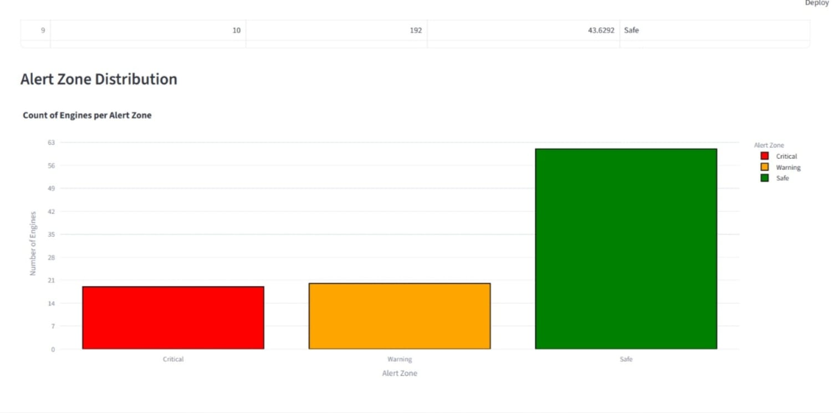
Result :

Slide 9
User Interface :
Built a Flask web app allowing users to upload sensor data and visualize predicted RUL.
UI features:
Data upload form
Real-time RUL prediction output
Graphs comparing actual vs predicted RUL

Slide 10
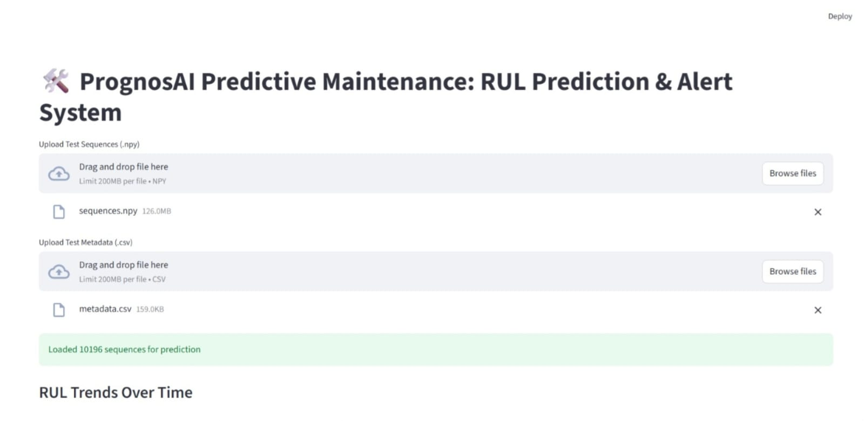
User Interface :

Slide 11
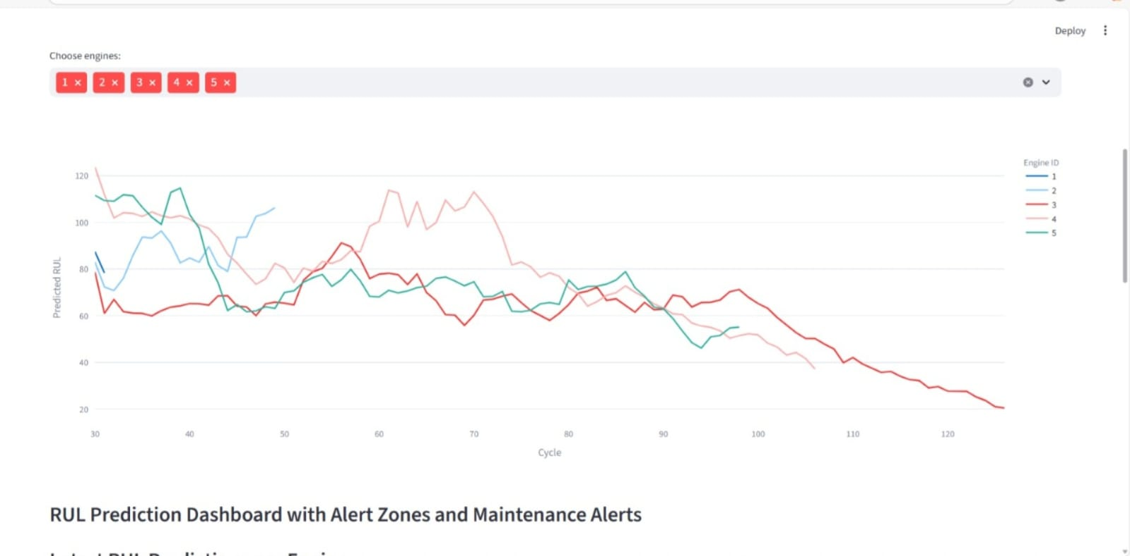
Output :

Slide 12
Future Work :
Expected outcomes include accurate RUL predictions and visual dashboards for maintenance alerts. Future work involves integrating real-time IOT sensor data, enhancing model interpretability, and deploying the system in industrial environments.

Slide 13
Conclusion
PrognosAI demonstrates how AI and deep learning can revolutionize industrial maintenance. By predicting equipment failures ahead of time, it reduces downtime, improves safety, and increases productivity. The project lays the foundation for smart, data-driven asset management.

Slide 14
THANK YOU

